Slide 1
Use case-1
Imran Mahmud

Slide 2
Use case diagram
A requirements analysis concept • A case of a use of the system/product • Describes the system's actions from a the point of view of a user • Tells a story • A sequence of events involving • Interactions of a user with the system

Slide 3
How do we describe use cases?
Textual or tabular descriptions
User stories
Diagrams

Slide 4
Use Case Descriptions
actors - something with a behavior or role, e.g., a person, another system, organization.
scenario - a specific sequence of actions and interactions between actors and the system, a.k.a. a use case instance
use case - a collection of related success and failure scenarios, describing actors using the system to support a goal.

Slide 5

Use cases vs. internal features
consider software to run a cell phone:
Use Cases
call someone
receive a call
send a message
memorize a number
Point of view: user
Internal Functions
transmit / receive data
energy (battery)
user I/O (display, keys, ...)
phone-book mgmt.
Point of view: developer / designer

Slide 6
What is an Actor?
Include all user roles that interact with the system • Include system components only if they responsible for initiating/triggering a use case. • For example, a timer that triggers sending of an e-mail reminder • primary - a user whose goals are fulfilled by the system • importance: define user goals • supporting - provides a service (e.g., info) to the system • importance: clarify external interfaces and protocols • offstage - has an interest in the behavior but is not primary or supporting, e.g., government

Slide 7
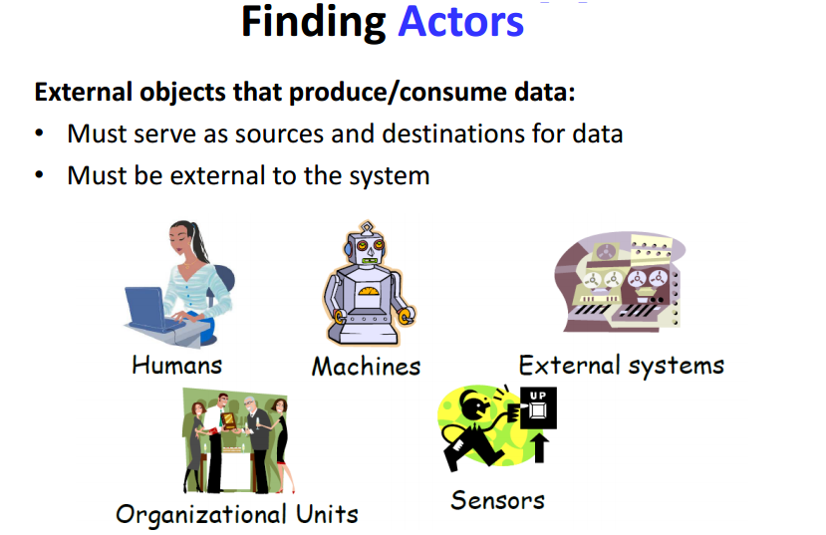

Slide 8
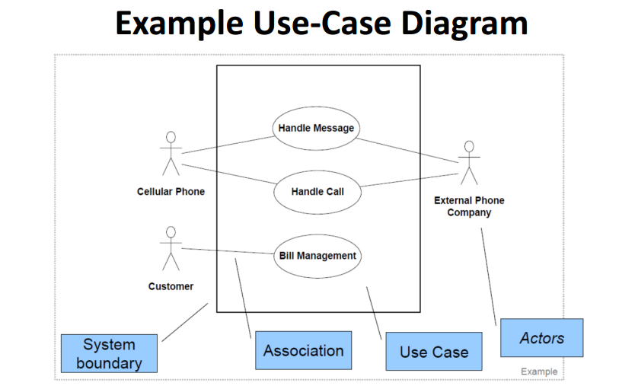

Slide 9
Use-Case Diagrams: 2 (POST)
POST: Point of Sale Terminal
Use Case
POST
System Boundary
Buy Item
Log In
Cashier
Customer
Refund a Purchased Item
Adapted from Larman “Applying UML and Patterns”

Slide 10
Example use case diagram 3
Customer
Order Food
Service Person
Applicant
Hire Employee
<<uses>>
Reorder
supplies
Manager
Supplier
<<uses>>
Track sales
and inv. data
Produce
mgt. reports

Slide 11
Pros and cons of use cases
pro:
they hold functional requirements in an easy-to-read text format
they make a good framework for non-functional requirements & project scheduling
con:
they show only the functional reqs
design is not done only in use case units

Slide 12
Exercise
ABC university brought a software where registrar can add courses, students can register and teachers can upgrade the grade. All three actors can see the course information while adding, registering or upgrade the grade.
Draw Use case for four functional requirement of this system

Slide 13
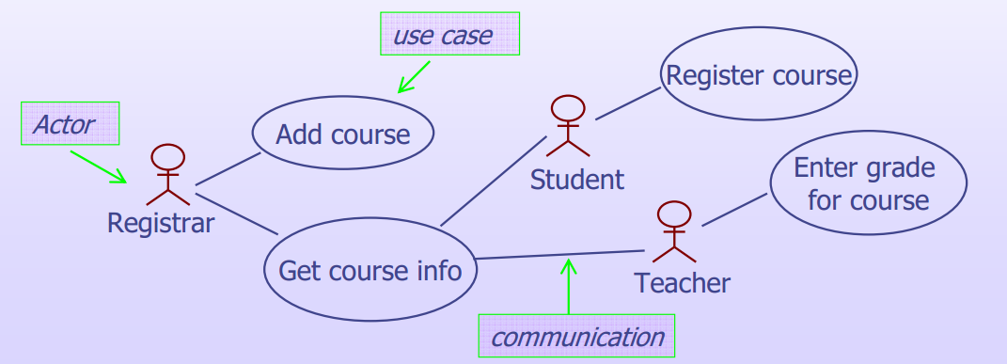

Slide 14
HACS
Homework assignment and collection are an integral part of any educational system. Today, this task is performed manually. What we want the homework assignment distribution and collection system (HACS for short) to do is to automate this process.
HACS will be used by the instructor to distribute the homework assignments, review the students’ solutions, distribute suggested solution, and distribute student grades on each assignment.
HACS shall also help the students by automatically distributing the assignments to the students, provide a facility where the students can submit their solutions, remind the students when an assignment is almost due, remind the students when an assignment is overdue.

Slide 15
HACS Use-Case Diagram

Slide 16
HACS Use-Cases
Use case: Distribute Assignments
Actors: Instructor (initiator)
Type: Primary and essential
Description: The Instructor completes an assignment and submits
it to the system. The instructor will also submit the
due date and the class the assignment is assigned for.
Cross Ref.: Requirements XX, YY, and ZZ
Use-Cases: Configure HACS must be done before any user
(Instructor or Student) can use HACS

Slide 17
Alternate HACS

